Slide 1
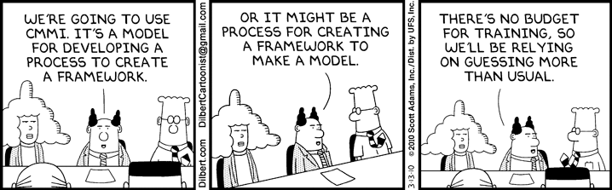
Systems Analysis and Design 10th Edition
ToolKit A– The Systems Analyst’s Toolkit – Communication Tools

Slide 2
Chapter Objectives
List overall guidelines for successful communications
Write effective letters, memos, and e-mail messages
Measure the readability of written material
Organize and prepare written reports that are required during systems development

Slide 3
Chapter Objectives (Cont.)
Follow guidelines for effective oral communication
Plan, develop, and deliver a successful presentation
Use effective speaking techniques to achieve your objectives
Manage and strengthen your communication skills

Slide 4
Successful Communication Strategies
Why, Who, What, When and How are important questions that you must answer before you communicate
WHY - Know why you are communicating, and what you want to accomplish
WHO – The needs of users depend on their organizational and knowledge levels
WHAT - Know what is expected of you and when to go into detail

Slide 5
Successful Communication Strategies (Cont.)
WHEN - Know when to speak and when to remain silent and let others continue the discussion
HOW - Strengthen your communication skills by using Toolkit suggestions, reflecting upon your own experiences, and observing successful and unsuccessful techniques used by others

Slide 6
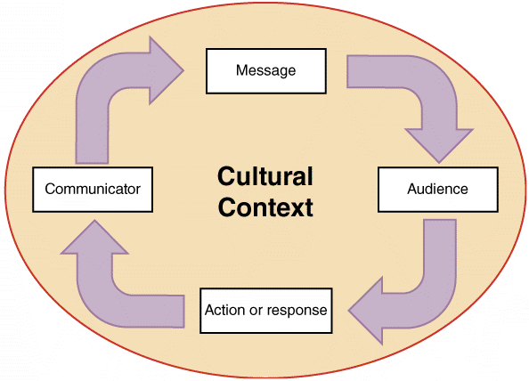
Successful Communication Strategies (Cont.)
Cultural Context
Cultural factors can include geography background, educational level, and societal differences, among others
These differences must be considered when asking and answering questions
Know Your Subject
Adopt a specific preparation strategy and before a presentation, consider what others expect you to know and what questions they will ask
FIGURE TK A-2 Every communication takes place within an overall cultural context

Slide 7
Written Communications
Writing Style and Readability
Know your audience and use terms that readers will understand
Use the active voice whenever possible
The active voice sentence “Tom designed the system,” is better than, “The system was designed by Tom,” which is an example of the passive voice
Keep your writing clear, concise, and well-organized. Each paragraph should present a single topic or idea
Use an appropriate style – a conversational tone in informal documents and a business tone in formal documents
Use lists to organize the material and make it easier to understand
Use short, easy-to-understand words

Slide 8
Written Communications (Cont.)
Writing Style and Readability (Cont.)
Avoid repeating the same word too often and use a thesaurus
Check your spelling
Check your grammar
Review your work carefully and double-check it for spelling, grammatical, and typographical mistakes

Slide 9
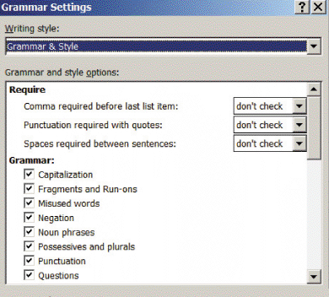
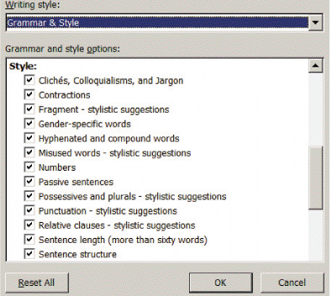
Written Communications (Cont.)
Writing Style and Readability (Cont.)
FIGURE TK A-3 You can set the grammar checker in Microsoft Word to check grammar rules only, or you can configure it to check your writing style

Slide 10
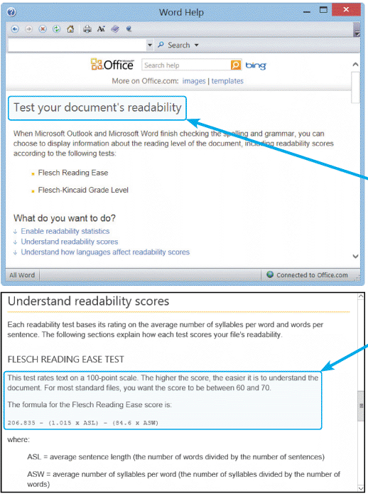
Written Communications (Cont.)
Writing Style and Readability (Cont.)
The Flesch Reading Ease score measures the average sentence length and the average number of syllables per word and rates the text on a 100-point scale
FIGURE TK A-4 Two popular readability measurement tools are the Flesch Reading Ease Score and the Flesch-Kincaid Grade Level Score

Slide 11
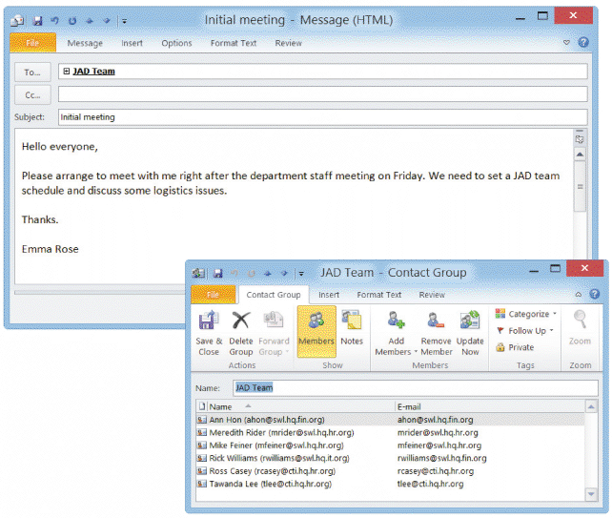
Written Communications (Cont.)
E-Mail, Memos, and Letters
E-mail usually is less formal than other written correspondence
Remember that e-mail messages often are forwarded to other recipients or groups
Create a distribution list that includes the members and their e-mail addresses
External communications often require letters printed on company letterhead
FIGURE TK A-5 Microsoft Outlook allows users to create distribution lists for sending e-mail messages

Slide 12
Written Communications (Cont.)
Social Media at Work
THE BACKDROP - Social media is used in corporate marketing plans to create excitement, call attention to products, and reach out to a young, active, socially aware market
ADVANTAGES- IT professionals can use social media to network with others, find out about new technology, meet colleagues, discuss career issues, and maintain a Web-based presence that would have been impossible just a few years ago
RISKS - know the rules, observe the rules, and when in doubt — don’t!
THREE WAYS TO GET FIRED
Brag about a new marketing strategy before it has been publicly announced
Be somewhere or do something that might degrade your company’s image launch an angry verbal attack on your fellow employees or managers

Slide 13
Written Communications (Cont.)
Social Media at Work (Cont.)
OTHER ISSUES – Use a “need to know” approach and direct your messages to those who have a legitimate interest, and are people you trust
Avoid blanket messaging and broadcasting
Think about whether the content is appropriate for the site you are using
Social networking, instant messaging, and cell-phone texting are popular because they allow informal, interactive, and immediate communication
Exercise good judgment and common sense
No one will remember all your excellent messages - but they will never forget the inappropriate ones

Slide 14
Written Communications (Cont.)
Netiquette
Netiquette combines the words Internet and etiquette
Common rules and tips:
Always fill in the subject field with a brief description of the contents
Be brief — in most cases, less is more
Be professional
Be sure to check your spelling
Don’t forward jokes or chain letters without the permission of the recipient
Don’t overuse humor or sarcasm that might work in a face-to-face situation, but not in an e-mail

Slide 15
Written Communications (Cont.)
Netiquette (Cont.)
Don’t type in all caps — it is like YELLING!
Don’t use colored fonts, background, or images
Don’t use the return receipt request feature unless there is a valid business reason to do so
If you have large attachment files, try to zip or compress them before sending
If you send a message to a group of people, especially if they don’t know each other, use a blind copy (Bcc) for all of the recipients in order to shield the addresses from the entire group

Slide 16
Written Communications (Cont.)
Netiquette (Cont.)
Never give out personal contact information of others without their specific permission to do so
Never include personal information unless you are 100% sure of your recipient and no other means of communication would provide better privacy and security
Remember that there are copyright laws
When replying, don’t include all the earlier messages unless there is a reason to do so

Slide 17
Written Communications (Cont.)
Workgroup Software
Groupware enhances employee productivity and teamwork
Users can manage and share their calendars, task lists, schedules, contact lists, and documents
Popular examples of workgroup software include Microsoft Outlook and Novell’s GroupWise
Google Docs offers free, Web-based collaboration
Teams can work on centrally stored documents instead of
e-mailing drafts back and forth
Teams also can use powerful multi-authoring software, such as Adobe Acrobat, to add revisions, notes, and comments to PDF documents

Slide 18
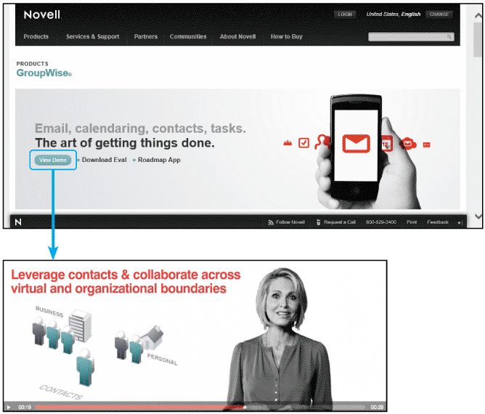
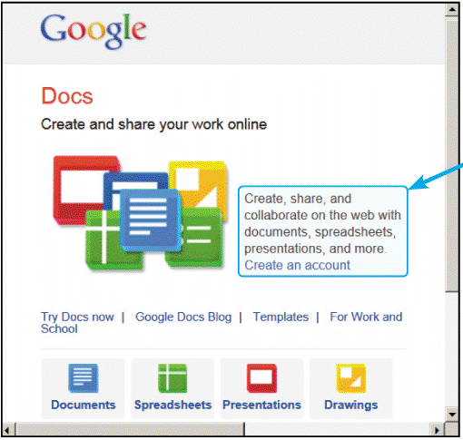
Written Communications (Cont.)
FIGURE TK A-7 Workgroup software, such as Novell’s GroupWise, allows a user to collaborate with others by sharing documents and folders
FIGURE TK A-8 An employee team can use Google Docs to work on centrally stored documents

Slide 19
Written Communications (Cont.)
Reports
Include the preliminary investigation report
The system requirements document at the end of the systems analysis phase
The system design specification at the end of the system design phase
The final report to management when the system goes into operation
Microsoft Word provides many pre-made templates that you might be able to use for your report
Word documents can be transformed into Adobe PDF format, which offers several advantages

Slide 20
Written Communications (Cont.)
Reports (Cont.)
PDF FILES:
Totally compatible because the PDF format travels well, and can be used and interchanged among virtually all devices, operating systems, applications, and hardware platforms
More secure because a PDF document can’t readily be changed without leaving some trace, and the PDF format does not permit executable code, such as macros, to be embedded

Slide 21
Written Communications (Cont.)
Reports (Cont.)
INTRODUCTION:
Usually includes a title page, table of contents, and brief description of the proposal
EXECUTIVE SUMMARY
Used to summarize the entire project, including your recommendations, in several paragraphs
Generally, the executive summary should not exceed 200 words or one page
FINDINGS
Describes the major conclusions reached during the systems analysis phase
Can be detailed or summarized, depending on the project
Must explain the logical design of the new system in a way that nontechnical managers can understand clearly

Slide 22
Written Communications (Cont.)
Reports (Cont.)
RECOMMENDATIONS
Presents the best system alternative, with a brief explanation that should mention economic, technical, operational, and schedule feasibility
COSTS AND BENEFITS
List the advantages, disadvantages, costs, and benefits of each major system alternative
APPENDIX
Put supporting documents in an appendix located at the end of the document

Slide 23
Oral Communication
Define the Audience
Senior managers often prefer an executive summary rather than a detailed presentation
In smaller companies top management may be more involved in day-to-day activities
If you consider the expectations of your audience and design your presentation accordingly, you will improve your chances of success

Slide 24
Oral Communication (Cont.)
Define the Objectives
Inform management of the status of the current system
Describe your findings concerning the current system problems
Explain the alternative solutions that you developed
Provide detailed cost and time estimates for the alternative solutions
Recommend the best alternative and explain the reasons for your selection

Slide 25
Oral Communication (Cont.)
Organize the Presentation
Plan for three stages: the introduction, the information, and the summary
Define Any Technical Terms
Avoid specialized or technical terminology whenever possible
Prepare Presentation Aids
Much of what people learn is acquired visually so help the audience follow the logic of your presentation and hold their attention
Visual aids also can direct audience attention away from you, which is helpful if you are nervous when you give the presentation
You can use a visual aid with an outline of topics that will help you stay on track

Slide 26
Oral Communication (Cont.)
Visual Aids
Use whiteboards, flip charts, overhead transparencies, slides, films, and videotapes to enhance your presentation
Presentation Software
Multimedia Slide shows can be created using Microsoft PowerPoint
Some overall guidelines include the following
prepare an overall outline that will be the foundation of your presentation
A fine line exists between providing too little information and too much
Display one topic per slide, and try to follow the rule often called the 7 by 7 rule: no more than seven items per slide, and no more than seven words per item (this slide breaks that rule)

Slide 27
Oral Communication (Cont.)
Presentation Software (Cont.)
When displaying a list of items, consider using a series of slides to add each point sequentially
Use bullets rather than numbers, unless you are showing a specific sequence or order
Choose easily readable sans serif style fonts
Use appropriate point sizes for titles and body text
Select special effects carefully — too many graphics, colors, sounds, or other special effects will distract your audience
Include tables or graphics, but keep them simple and easy to understand

Slide 28
Oral Communication (Cont.)
Presentation Software (Cont.)
Strive for a consistent look and feel among your slides, and position visual elements in the same place on each slide
Be sure to check spelling and grammar!
During the presentation, do not read your slides to the audience!
Deliver a presentation that can be viewed easily from anywhere in the room

Slide 29
Oral Communication (Cont.)
Practice
Rehearse several times to ensure that the presentation flows smoothly and the timing is correct
Practicing will make you more comfortable and build your confidence!
The Presentation
SELL YOURSELF AND YOUR CREDIBILITY!
Show confidence about the subject and your recommendations

Slide 30
Oral Communication (Cont.)
The Presentation (Cont.)
CONTROL THE PRESENTATION
Control the discussion, maintain the pace of the presentation, and stay focused on the agenda — especially when answering questions
ANSWER QUESTIONS APPROPRIATELY
Let your audience know whether you would prefer to take questions as you go along or have a question-and-answer session at the end
Make sure that you understand the question before you answer it

Slide 31
Oral Communication (Cont.)
The Presentation (Cont.)
USE EFFECTIVE SPEAKING TECHNIQUES
Speak clearly and confidently and project a relaxed approach
Online Presentations
Broadcast a live presentation as slides with an audio narrative or use Cisco’s WebEx to get real-time participation

Slide 32
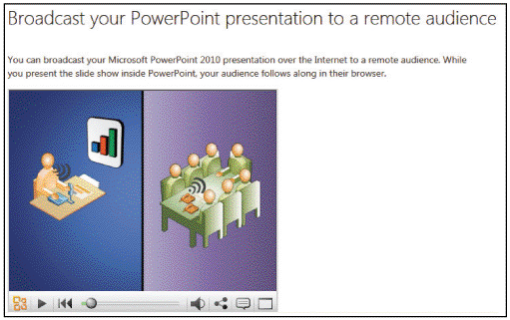
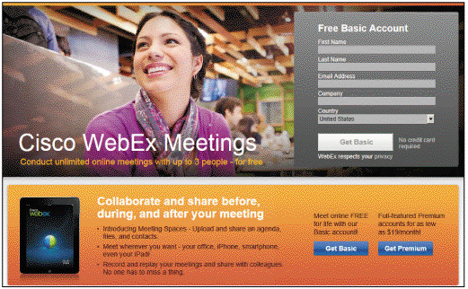
Oral Communication (Cont.)
FIGURE TK A-11 With PowerPoint 2010, you can broadcast a live presentation to a remote audience, who can view it in a Web browser
FIGURE TK A-12 Cisco’s WebEx can handle live audio and video, and allows you deliver an interactive Webinar.

Slide 33
Managing Your Communication Skills
Communicating is like any other activity — the more you practice, the better you become
Some people find it difficult to stand in front of a group and deliver a presentation or report
Toastmasters offers a friendly environment where members critique each speech in a positive manner, note the strengths, and offer suggestions about what might be improved

Slide 34
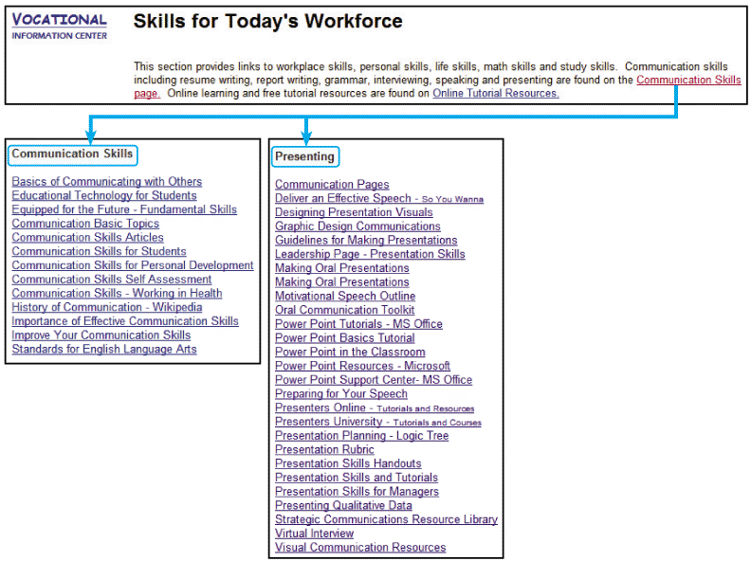

Managing Your Communication Skills (Cont.)
FIGURE TK A-14 The Vocational Information Center offers many online courses and tutorials on
communications skills.
FIGURE TK A-15 Toastmasters International is famous for helping people become better public speakers

Slide 35
Toolkit Summary
Your success as a systems analyst depends on your ability to communicate effectively
Know why you are communicating, what you want to accomplish, who your targets are, what is expected of you, and when to go into detail
You will be judged by your written work, so it must be free of grammatical, spelling, and punctuation errors
Social media is extremely popular because it allows informal, interactive, and immediate communication

Slide 36
Chapter Summary (Cont.)
Use readability measurement tools such as the Flesch Reading Ease score and the Flesch-Kincaid Grade Level score
Reports should have a cover memo and might include an introduction, an executive summary, findings, recommendations, time and cost estimates, expected benefits, and a data section
You might have to deliver several presentations to different audiences at different times during the SDLC
Presentations are an important form of oral communication, and you should follow specific guidelines in preparing your presentation

Slide 37
Chapter Summary (Cont.)
When you develop slide presentations, you should follow the 6 by 6 rule or 7 by 7 rule and other guidelines that will make your slides easy to read and understand
When you give the presentation, you are selling your ideas and your credibility
Every IT professional should have a strategic plan to manage and improve written and oral communication skills

